Slide 1
Storyboard for a 15-Minute Investor Presentation
1 – Title | 2 – Problem or Opportunity | 3 – Quick Glimpse: Technology Overview | 4 – Customer Discovery (primary research) | 5 – Market(s) (secondary research)
6 – Technology: Product | 7 – Technology: Product Plan | 8 – Product: Technology Roadmap | 9 – Competitors | 10 – Operations
11 –Alliances | 12 – Management Team, Board of Directors, and Advisors | 13 – Pro-forma Financials: P&L | 14 – Pro-forma Financials: Distribution of Funds | 15 – Exit Strategy
16 – Strategic Issues | 17 – Summary / Recap of “the Ask” | 18 – References | 19 – Q and A
Notes:
This presentation template is based on an original by EV xxxx.
This slide is not part of your presentation. It is here to show you the contents and order of your slides.
Tip: Professionalism. Include a footer for a professional look. Use the Insert tool just as you do for Word documents.
Tip: Platform. Remember: Presentations are a verbal activity. Limit the amount of text on the slide. Rely instead on memorable headings, graphics, evidence, and examples to capture and hold your audience’s attention.
Tip: Audience. Remember: Your audience cannot go back and “re-hear” information as they can re-read in a text document. You must build in repetition so that the audience remembers and understands your points. Use transitions, a theme, re-phrasing and other techniques to build in needful repetition.
Tip: Key Ideas. Before building your presentation, decide on the 2-3 main points you want the audience to remember. These are definitely points that need to be repeated often and in new and interesting ways. Use your Purposeful Thesis Statement to help you identify your key points. WHO should do WHAT and WHY?

Slide 2
Investor Opportunity: Name of Product Tagline or Slogan
Logo
Graphic
Team Member Names
Name of Company / Department
Date
Notes:
This slide is up before you begin speaking, while people are entering the room.
It reminds them of who you are and what the meeting is about.
Tip: Titles. The title slide is your first chance to connect with your audience, so be sure to say or show the value of the idea you are presenting (your tagline or slogan).
List the team names in alphabetical order by last name.
YOU MAY CHOOSE YOUR OWN SLIDE DESIGN, BUT YOU MUST INCLUDE THE ELEMENTS YOU FIND ON THE TEMPLATE FOR EACH SLIDE.
NOTE: This template uses the same fonts, Calibri and Cambria, as the other Presentation and Report templates. The consistent fonts and formatting give the same look and feel for all documents produced by DetroitMercy’s Mechanical Engineering department.
This template doesn’t include an Overview slide, which is standard for business presentation. So you will have to do this verbally. Give the audience a brief idea of the topics you will be covering.
Tip: Audience. Be sure to consider your audience: What should you show? What should you say? Make use of the Notes section to capture the gist of your comments.
Tip: Tone. Be sure to use the correct tone in addressing this audience (no “you guys” instead “Thank you for giving us the time to present…” (To break the “you guys” habit, train yourself to stop after “you.” Get your teammates to help.)
A sample Title slide follows.
Transition: The thank you statement can act as a transition from the title slide to the next slide “Problem / Opportunity.”

Slide 3
Anatomy of a Title Slide
Notes:
NOTE: Some examples used in this template are based on the AgriDronz scenario explored in the presentation on Toulmin logic (see BlackBoard “Persuasion”). Others are pulled from actual ENGR 1080 student presentations.
Now let’s take a look at this mostly effective title slide and see what works and what could be tweaked.
First, what works: The design is clean and looks professional. The logo artwork is large and readable (amazon go Rx). The business unit name is readable (Amazon Go Pharmacy).
Second, what could be tweaked: The presenters’ names need to be in alphabetical order. Plus the team needs to add a tagline that captures the value of the product idea. Ex., “All the convenience of Amazon Go shopping – for medications” or something like that. The team describes the value in the Notes section of various slides, but it needs to be captured here – immediately – for the investor audience.
Tip: Thesis Statement. Your purposeful thesis statement is a good place to look for the “value.” WHO should do WHAT and WHY – look at the “why” to see the rationale you’ve used. Be sure to share this – repeatedly – with the investor audience.

Slide 4
Problem or Opportunity
If you use text, make it readable.
Use an informative title to engage the audience. Ex., “Pollinating Bees Are Dying”
Insert Graphic
Ex.,
Graph of bee deaths
Photo of dead bee
Illustration of crop loss due to lack of pollination
Notes:
Always start with the problem. Build your product/service around a problem or opportunity that exists. Explain or show this problem. Remember the audience: They ARE NOT consumers who will buy your product. They ARE people with money who may invest in bringing your product to market. So don’t use second person (ex., “Have you ever…?”). Instead, say “Millions of Americans every year…” (use third person and provide evidence).
Once the problem is clear, put a size on the problem/opportunity. How many people are affected? How many possible customers will your product reach?
Cover briefly why the problem has not been solved before (current technology).
State what makes it possible for the problem to be solved now (ex., miniaturization of batteries or discovery of a new process).
Then offer your solution – state your product by name and that you need $xxx in investment to bring the product to market. Don’t be shy. Investors know that you will be asking for money.
Tip: Slide Design. Note the use of the footer, which lends a professional, unified look to your presentation, and the ratio of text:graphics (minimum 50:50, with preference for fewer words).
A sample Opportunity slide follows.
Transition: State that you/your team has developed a technology to meet this need / solve this problem, along with a Technology Plan for bringing the product to market (this reassures the investors that you have a credible plan for launching the product using their money).

Slide 5
Anatomy of a Problem / Opportunity Slide
Notes:
Let’s talk about what works well in this slide and what needs tweaking.
Tip: Titles. Create an effective title – one that engages vs. simply describes – in this case, try combining the title with the bullet: Problem: Accidental Overdoses. Now you have a better title, and you can eliminate the text box, thus de-cluttering the slide.
The line graph has a clear, limiting title that includes the topic, dates, and place. The axes have legends and the lines are color-coded with callouts. The team needs to add a credit line, but otherwise this is an effective graphic that supports their claim about a growing problem.
The photo is a dramatic way to underscore the problem. It uses a pathos appeal, evoking sorrow or fear or frustration among the audience.

Slide 6
Quick Glimpse: Technology Overview
If you use text, make it readable.
Use an informative title to engage the audience. Ex., “Pollination 2.0”
Insert Graphic
Ex.,
Graph of historic uses of “artificial” pollination
Photo of pollinator drone
Illustration of crops pollinated artificially
Notes:
Your goal with this slide is to satisfy the investor’s immediate need to know how you plan to solve the problem or take advantage of the opportunity.
Don’t over-explain. You have three slides later on to fully flesh out your technology idea.
A sample Quick Glimpse slide follows.
Transition: Say that you want to show the “solution” quickly, then build a business case for how it will work (and thus earn money for the investor).
Importantly, what you want to show next is that a market truly does exist for this technology.
You know this because you have done customer discovery and market research, which you then talk about. You are showing that your product idea is rooted in a real problem that people have.
Basically, you want to answer: Who will want to buy this product? How do you know?

Slide 7
Anatomy of a Quick Glimpse Technology Slide
Banking convenience for customers
Our product: QR Code
Linked to customer’s bank account.
Scan it!
Withdraw amount of money customer wants.
Notes:
Let’s look at what works and what needs tweaking in this slide.
The title captures the value of the technology.
The technology is named and shown.
Three “conveniences” are shown.
The amount of technical detail is limited. That will come later.

Slide 8
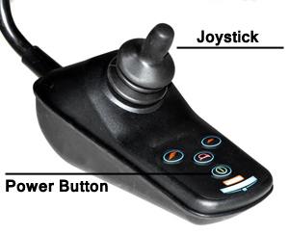
You-Drive Technology
Anatomy of a Quick Glimpse Technology Slide
Features
Padded floor for a comfortable ride
Handle bars for support
Tires that can drive on a variety of surfaces material
Slim profile to fit through doors and small spaces
Easy-to-operate controls
Notes:
Here’s another example of a quick overview of a technology that addresses a specific problem. Notice the limited explanation below, which appeared in the Notes section.
You-Drive is a mobility device for elderly people. It is equipped with a padded floor so that it is comfortable to operate. This device has handle bars that offer support. The tires can drive on all types of material therefore it will not get stuck on thick carpet or other terrain. You-Drive comes with a joystick that makes it easy to steer. This device will be suitable for elderly people with the ability to stand. They will need no assistance in using it and it will allow them to move around more efficiently.
Our company is asking for $100,000 dollars to create the You-Drives and put them on the market.

Slide 9
Customer Discovery
If you use text, make it readable.
Use an informative title to engage the audience.
Insert Graphic
Ex., Table of responses to a customer survey
Ex., List of potential customers
Ex., Photos of customers using existing products
Notes:
Again, you must show (and tell) your investor audience that your product is the result of audience study. You / your team has thought about and researched potential users of your product.
Be sure to discuss these points:
What is better about your product or service from the user’s point of view? This is the “end benefit.”
Is there a quantifiable dollar benefit to the customer purchasing your product?
What is your “channel of distribution?” That is, how will you reach these customers?
What is the price of your product or service and how did you arrive at it?
NOTE: You will cite evidence in this section.
For instance, your “customer discovery” work is primary evidence that shows you actually talked with potential users of your product (vs. guessing what a customer might want or need).
In the same way, secondary evidence – market research -- will support your claims about what customers want.
Tip: Audience. Remember your audience: What can you show (ex., a table or chart) vs. adding text to your slide?
Several sample Customer slides follow, some with Notes pages.
Add a link from your Customer Research to the Market slide, which follows. You’ve described your potential customers – now tell the investors how many customers there are and how you know this.
Transition: When you have finished discussing the size of the market, re-introduce your technology as a solution based on this research. Emphasize that your technology flows from what customers want and market predictions. This close relationship between ideas reassures investors that you’ve “done your homework.”

Slide 10
Anatomy of a Customer Slide and Notes
Notes:
Let’s look at what works in this slide and what needs tweaking.
First, what works: The photos are helpful as they show that this is a B2B (business-to-business) vs. a B2C (business-to-consumer) product. That means the team knows the audience for the product is a mixed executive/SME (subject matter expert) or at least a technician-level audience. This is very different from marketing to a consumer audience, so it’s good that the team displays this knowledge early in the presentation.
Also, the team does use credit lines, the company’s logo, and minimal text.
What needs tweaking: The cost line is unclear because of the word “hospitals” at the end. Also, the cost of the device is not the major point for this slide. The ability to deploy staff more effectively is the key point – a productivity improvement and hence almost surely a cost savings for the customer. The team says this in the Notes, but the slide has a different main point.
The team needs to proofread the slide for random capitalization and inconsistencies.
Nevertheless, the team shows a good understanding of who the end customer is: Administrators (executives whose job is to evaluate money-related propositions) and, possibly, nurses (technicians who will use the new product).

Slide 11
Anatomy of a Customer Discovery Slide
Notes:
Let’s look at what works in this slide. This team’s technology was a phone app for ordering and managing pharmacy purchases.
This slide captures what the team learned when they interviewed potential customers for their technology. Listed here are the results of their primary research.
The title is clear, and the list format works well.
Question: Is the bulleted subhead necessary? Could this subhead be blended with the major head? If so, the point size on the list could be increased for easier reading by those in the back row.

Slide 12
Customer Discovery: Survey
Anatomy of a Customer Discovery Slide
Created Google form
Found amputees with prosthetics on social media (Instagram, Facebook, Twitter)
Asked them to complete survey
What kind of prosthetic do you have?
How long have you had it, and where did you get it?
What are current problems you face with your prosthetic?
Has strength ever been an issue when using your prosthetic?
Why would or wouldn’t having feeling in your prosthetic improve its capability?
Notes:
Let’s look at what works in this slide. This team’s technology was artificial skin applied to prosthetics. The “skin” senses heat and pressure.
This team needed information from a very specific source, so interviewing friends and families wouldn’t work. Instead, they created a Google form to reach those very specific “customers.”
This slide captures their questions. The following slide captures their analysis of the data. It is this analysis that underpins the need for the technology.

Slide 13
Survey: The Results
Anatomy of a Customer Discovery Slide
For arm prosthetics
Improve grip and accuracy of motion
Temperature control
For leg prosthetics
Improve balance
Temperature control
Notes:
Let’s look at what works on this slide and what could be tweaked.
The title could be used to capture the main takeaway from the survey.
The photos are very dramatic in that they show state-of-the-art prostheses. Note that the one on the bottom illustrates the idea of “pressure,” which is one of the selling features of this technology. Photo credits are needed.
The text is minimal, which is good. However, the team needs to include the other key finding discussed in the next bullet. Often, research tells you about the customer and sometimes reveals the real market.
The notes section included two key outcomes that helped this team re-define who its “customer” would be – not the patients themselves.
Learned that feeling might only be beneficial for those with recent amputations because they remember movement and feeling better
Won’t work for everyone, which is why it would be better to sell to rehab centers because they know clients better
The notes section also explained about the users – not the customers – of their product:
100% of those surveyed have experienced problems with their prosthetics
100% of those surveyed believed feeling would improve their prosthetics

Slide 14
Market(s)
If you use text, make it readable.
Use an informative title to engage the audience. Ex., “Growing U.S. Market” or “Commercial and Residential Markets”
Insert Graphic
Ex., Pie chart of market share
Ex., Line graph of market growth
Ex., Bar graph of types of customers
Notes:
This slide captures the secondary research you’ve done to support your claim that this is a demand for your product.
Tip: Graphics. Remember to follow the conventions (rules) for graphics. Make sure to use the correct graphic to display the information. Ex., use line graphs to show trends over time. Plot them correctly. Ex., when using a pie chart, start at 12 o’clock and move clockwise from the largest slice to the smallest. Use pullouts, trend lines, keys, leader lines, etc. as needed to emphasize points and de-clutter your graphic. The next slide shows a problematic graphic as an illustration of what not to do.
Tip: Titles. Always use a clear, limiting title that makes a point (vs. being strictly descriptive). Ex., “Market Potential” suggests more than “Market Growth.”
Tip: Numbers. Always offer a unit of measurement and keep the unit with the number. Ex., “10 lbs.” or “15 people.”
Tip: Numbers. Add meaning to percentages, money, and other numbers by anchoring them with a date and place. Ex., “In 2017, 80% of the population in New York City owned a cell phone.” Without the place and time, the 80% is meaningless. Of course, you’d also mention the source of the 80% claim.
Tip: Credit Lines. When using someone else’s numbers or graphics (a third-party source), you must use a credit line. They are small so they don’t distract from the images. Full citations for these images will be offered in the References slide at the end of the presentation. This template uses 12 pt. Cambria for credit lines, captions, and references and Calibri for titles and text on slides.
A sample Market slide is also included.
Transition: Now move from how much product you can sell to a more comprehensive description of your product, system or technology.

Slide 15
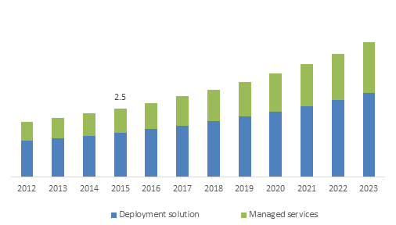
Anatomy of a Problematic Graphic
Title?
Unit of measurement?
Legend?
Legend?
Credit Line?
Notes:
Let’s look at how effective this slide is.
Where to start?? Well, there’s no title, so the audience has no idea of what to expect. The presenter has squandered the chance to make a first impression and deliver a key idea.
What is the context for the information presented in the bar graph? We have dates, but no place. Is this company data? Market data?
What does the 2.5 refer to? Without a unit of measurement, the audience doesn’t know if this is dollars, a percentage, or people.
Without legends, the audience doesn’t know how to regard the increase from 2012 to 2023 – is this increase in dollars, services performed? Again, place is important. Deployment solution / managed services for whom? Where?
Clearly this graphic was taken from a third-party source, but no acknowledgement is given. That’s not just unethical – it’s illegal (as in stealing).

Slide 16
Anatomy of a Market Slide
Notes:
Here’s an example of a market slide that works better.
The title captures a key idea: The market is growing. Remember, investors want “proof” that there is sales potential before they write a check.
The subtitle captures another key idea: How large is the market? But what market? Pharmaceuticals? Phones? Apps? The Notes section of this presentation tells us that it refers to Apps, but let’s add that key word to the slide.
The bullets list key facts, which is good. What is better is to anchor the dollar amounts with dates and places. Ex., “$77 billion industry” would have more impact with “in 2016 in the U.S.” Then, the $188.9 billion takes on new meaning – the growth is put into perspective and the investor sees the huge jump from 2016 to 2020. It’s always important to include places, because the investor wants to know: “Is this a domestic (U.S.) market? Global?” If U.S. today, then global when? Try to anticipate the questions the investor will have.
The increasing smartphone reliance is emphasized because it supports the team’s technology plan.
What is less clear is the line graph. The reader would expect some evidence about market growth – of pharmaceuticals. What is shown is market growth for Amazon, which is interesting if Walmart is a competitor. Unfortunately, the graph wasn’t explained in the Notes section.
Tip: Research. You will want to show two ideas: Your primary research (Customer Discovery) and your secondary research (Market). Be sure to mention the sources in the Notes and include credit lines in the slide.

Slide 17
Technology and Product
If you use text, make it readable.
Use an informative title to engage the audience. Ex., “Technology Roadmap: AgriDronz”
Insert Graphics
Ex.,
CAD illustration, photo or other representation of your product
Flowchart or schematic of how your product works
Technology Roadmap
Notes:
You need to cover three points here, so you will need more than one slide:
Show the product (what does it look like?). Remember, your product is obvious to you because you know it so well. But if you can’t make it obvious to your audience now – in the first 30 seconds – you will lose them and the rest of your presentation will be wasted.
Explain the product (how does it work?). Include what is patented or proprietary about your product (this originality helps ensure profit). Describe how it takes advantage of current and future trends (ex., systems engineering or IoT interconnectedness).
Present the Technology Roadmap (what’s the plan for getting the product developed and market-ready?). Cover “barrier(s) to entry.” Why can you bring this product to market vs. competitors who cannot?
Tip: Audience. Consider your audience: How much technical detail do they need / want / understand? Limit the explanations.
Tip: Titles. Be sure to use a title for each graphic and use captions, callouts, keys, etc. as needed.
Examples of graphics for each of the three key points are offered on the following slides, along with transitions between them.

Slide 18
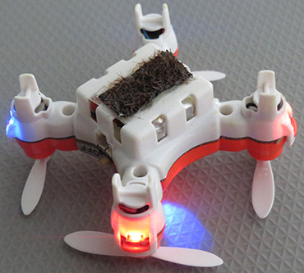
Tiny AgriDronz Pollinators at Work
Anatomy of a Product Slide
Image from Science News.
Image from Science News.
Notes:
This Product slide uses a photo to show the actual prototype, which clearly has been built. The illustration shows how the product works and acts as an indicator of the product’s size.
Tip: Title. Note the title. It is informative vs. descriptive – it tells what the product is doing and its value to the user (pollinating, tiny).
The photo and the illustration are both pulled from Science News, so credit lines are included. They are small so they don’t distract from the images. Full citations for these images will be offered in the References list at the end of the presentation.
Tip: Fonts. Use Cambria for the credit lines as this is the other font used for Mechanical Engineering documents.
NOTE: There is no explanatory text on this slide. You – the presenter – will have to walk the audience through the AgriDronz mechanism at the top and the process at the bottom.
Transition: Add a bridge from this slide to the Process slide, shown next.

Slide 19
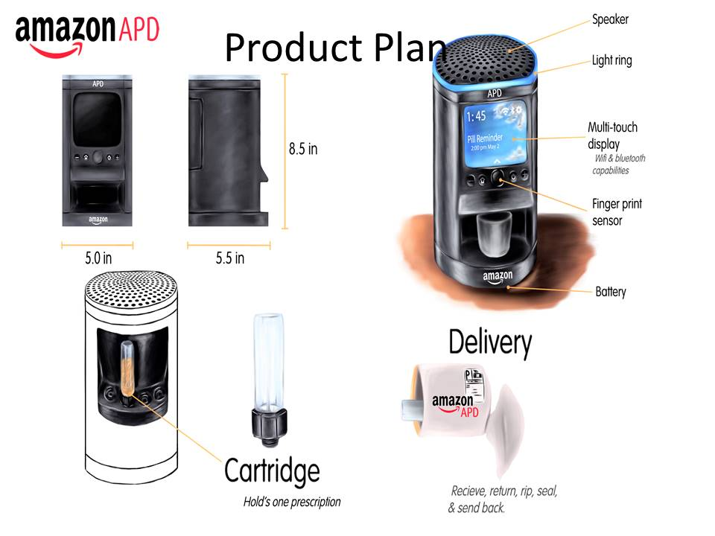
Anatomy of a Product Process Slide
Notes:
Why does this slide work? Let’s take it apart and find out.
Process: This slide shows the process – the presenter describes it. Notice the lack of explanatory text on the slide. It’s not needed.
Artwork: The team created the artwork on this slide: Logo, product illustrations. That’s why you don’t see credit lines.
Tip: Professionalism: This slide needs proofreading. It’s beautiful, but the credibility is hurt by the image covering part of the title and the typos (bluetooth vs. Bluetooth, Hold’s vs. Holds and recieve vs. receive). Be sure to use Spell Check, outside proofreaders, and reviews after each revision.
Transition: Be sure to add a bridge from the Product Plan to the Roadmap that lists the dates for how you will go from ideation to production.

Slide 20
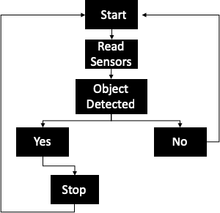
Product Plan
Anatomy of a Product Process Slide
Flowchart: Wheelchair Sensors
Notes:
Here’s another example of a product plan slide that answers the question: “How does it work?”
This team could push the title more to reveal a key idea. However, the focus on the flowchart vs. a bulleted list is effective in describing a process.
Transition: Add a jump from how the process works to the plan for producing the product (the Technology Roadmap, which is next).

Slide 21
Anatomy of a Technology Roadmap Slide
Notes:
Why does this slide work? Let’s take it apart and see.
The clear, limiting title tells the audience what the graphic is about.
Note the organization of this graphic. It uses color, lane indicators, and dates.
Tip: Timing. When there’s a good deal of information in a graphic, leave it up long enough for the audience to absorb the gist of it (which the presenter will be explaining).
Launch: The launch date is not highlighted (see Lane B, dark red box). The investor will need help from the presenter in realizing that 16 months after investing, the service will go live.
The next slide shows an example of a simpler Roadmap.

Slide 22
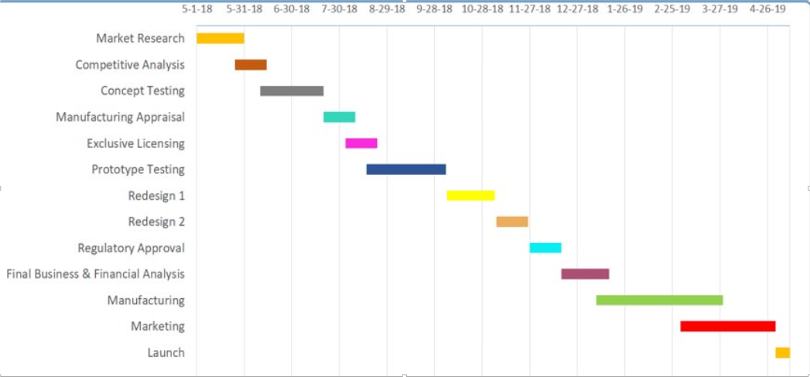
Anatomy of a Technology Roadmap Slide
Notes:
This Technology Roadmap graphic was pulled from the team’s Final Report. It shows a simpler version of the Roadmap than the previous sample.
NOTE: In a subsequent draft, this team would:
Add a title (and a Figure # for the Report version)
Add a caption (or Notes for the Presentation version)
Tip: Key Ideas. Notice the Roadmap starts with Market Research and ends with Launch – that’s what investors really want to see. When will the product go to market? Because that’s when sales begin, and they can start to recoup their investment.
Transition: Add a link from the this – last Technology slide – to who can get in the way of your success, your Competitors.

Slide 23
Competitors
If you use text, make it readable.
Use an informative title. Ex., “Competitor Technology” or “Competitor Technology Limitations”
Insert Graphic
Ex., Table of competitors with strengths and weaknesses
Ex., Logos of competitors
Ex., Photos of competitor products
Notes:
In Competitors, you do more than list competitors. You describe “current technology” and where it has worked and where it has failed.
So, do research about your competitors and then describe their approaches with their strengths and weaknesses. Their weaknesses are the springboard for reiterating how your technology will fill a gap, solve a problem, expand the market, etc.
Again, cite your research as you present. Show your investor that you have done your homework and know what’s available on the market today. Your research not only adds credibility to your pitch, it shows respect for the investor – you have a plan that uses the investors’ money wisely.
Tip: Research. You must do thorough research on existing technology and competitors. Your investors are smart people and will do basic research to confirm your claims. If you propose your app as a “unique idea,” the investor shouldn’t be able to find a similar technology already on the market.
Two sample Competitor slides follow.
Transition: Add a jump from your Competitor research to Operations slide, which is next. You’ve described your competitors’ technology – now tell the investors how you plan to produce your improved product.

Slide 24
Anatomy of a Competitor Slide
Notes:
Why does this slide work? Let’s take it apart and see.
First, what works well. The team uses graphics (logos) vs. text to show vs. list their competitors. This creates a more interesting slide. Plus, they use credit lines for the images (the artwork for the logos is owned by other companies, so a credit line is a must). The bullets make two key points.
Second, what could be tweaked. The title could be more informative. Yes, the slide shows the competitors. But it does more than that. It talks about existing technology and the pros and cons. It shows the major competitor. It lists companies that compete in a variety of ways: Brick and mortar, online, and delivery methods. You can’t capture all this in a title, but you could include a bit more information.
Tip: Titles. Remember, the title is the first chance to engage the audience and set them up to hear your main point.

Slide 25
Anatomy of a Competitor Slide
Notes:
This slide offers valuable information about this team’s competitors.
The main point: Technology on the market today includes apps for medical conditions, but not for medication regimens. That point is best made by the graphic at the bottom left. It could replace the text at the top of the gray box on the left.
The gray box on the right moves the audience from considering current technology to the team’s plan for beating the competition. The information in this box acts as the transition from “here’s what we need to do to succeed” to “here’s our plan (Operations) for succeeding.”
Tip: Slide Design. Make sure to preview your presentation. In this case, light gray text on a gray background proved difficult to read.
Tip: Professionalism. Note that Pharmaceutical is misspelled in the white box and that the text in the Competitor bullets doesn’t line up. These are easy fixes.

Slide 26
Operations
If you use text, make it readable.
Use a title that engages the audience. Ex., “Operation Start-up Plan” or “Operation Plan for XYZ Product”
Insert Graphic
Ex., Photo of production facility
Ex., List of suppliers or Map of supplier routes
Ex., Flow chart of Operation steps
Notes:
Operations gives an overview of your plans to produce your product. – to “bring it to market.” The idea is to present enough detail to persuade your investor that you have thought through the day-to-day activities required to get the product up and running.
This slide includes information such as “buy vs. build,” location of any production facilities and rationale, material choices, production processes (ex., manual vs. automated assembly), packaging delivery of product to customers – basically, the production process from prototype through delivery to customer.
Two examples of Operations slides follow.
Transition: The bridge from Operations to Alliances is the fact that your start-up will need help beyond financing in order to be successful. Again, showing the investors that you have “friends” lined up helps make you credible as a potential investment.

Slide 27
Anatomy of an Operations Slide
Notes:
Let’s see how this slide works.
The ratio of text:graphics is good, and the photo helps the audience visualize the storefront.
The list needs a little tweaking: The first bullet starts with a verb, while the rest do not.
The process in the list seems clear, from store site to hiring of employees, and the Notes help describe these steps. An earlier slide from this presentation showed the store’s floor plan, which is also helpful in visualizing not just how the store will look, but how it will operate.
Tip: Graphics. Be open to reusing graphics within the presentation.
This team’s idea builds on an existing Amazon business model, which will probably be cost-effective and thus appeal to investors. Slotting your product idea into an existing infrastructure shows you know how the business model works and where/how your product fits in.

Slide 28
Anatomy of an Operations Slide
Notes:
This team offers many details in this slide, all “proof” that serious thinking is behind this plan.
More than one wholesale supplier of medications has been identified, so that issue has been backstopped.
Plus the location of the facility makes sense (near Amazon headquarters), and the staff and their roles have been identified.
NOTE: This team used numbers vs. credit lines (ASME style) to identify the sources of their graphics. Complete citations for both appear in References at the end of the presentation. This template uses text vs. number credit lines for two reasons: 1) The audience needs to know the source at the time the graphic is viewed, and 2) The Reference list is not displayed long enough for all the citations to be read.

Slide 29
Alliances
If you use text, make it readable.
Use an informative title. Ex., “Network of Alliances” or “Alliances Build Strength”
Insert Graphic
Ex., Diagram/web of interconnected allies
Ex., Logos of allies
Ex., Photos of allies
Notes:
The Alliances slide identifies the agencies, organizations, and companies that will be helpful to your start-up. Agencies may include government regulatory or inspection agencies, organizations may include non-profits such as universities or hospitals that provide research, and companies are those that provide services such as target marketing, materials, assembly, or delivery, etc.
A sample Alliances slide follows.
Transition: From Alliances you move to the people who will help your start-up succeed, your Management Team, Board of Directors, and Advisors.

Slide 30
Anatomy of an Alliances Slide
Notes:
While this is an attractive and mostly readable slide, it does need tweaking.
First, let’s remove the small text in the title box. The team can say this idea or build it into the title. Ex., Alliances for Development and Safety.
The boldface subheads are useful as they show the three Alliances areas. However, let’s be consistent in centering the text below. Ex., In the case of Reliability, the team could force a line break after Healthcare to shorten this text box.
Tip: Consistency. Apple is the only company followed by an explanation. Let’s be consistent. Since the team is explaining all the other companies vs. showing their value, let’s do the same with Apple.

Slide 31
Management Team, Board of Directors, and Advisors
If you use text, make it readable.
Use an informative title to engage the audience. Ex., “Leadership Team for XYZ Product”
Insert Graphic
Ex., Organization chart of your management team
Ex., Photos of your Bd. of Directors
Ex., Logos of the companies affiliated with your Advisors
Notes:
The idea behind this slide is to show the depth of expertise supporting the start-up. No group of executives can supply all the necessary knowledge and experience, so in addition to the Management Team, the investor plan includes a Board of Directors and a list of Advisors.
An example of a Management Team, etc. slide follows.
Transition: Now that you’ve introduced who will run your company, you are ready to move to Financials. These are the numbers that illustrate the product story you have been telling. The Financials in many cases are the most important information for investors.

Slide 32
Anatomy of an Alliances Slide
Notes:
This team chose to list its leadership groups, starting with the Board of Directors. The Bd. of Dir. is a group of outsiders who oversee the major decisions made by the company and assess its financial performance on an ongoing and regular basis. Basically, they are the “boss” of the C-suite executives charged with the day-to-day operation of the company.
The Bd. of Dir. should be people in some way affiliated with the industry, knowledgeable about the product or market, or experienced in manufacturing, regulation or management. In the slide and the Notes pages, the team explains why it chose these three people for its Bd. of Dir.
The C-suite is the team of students who developed the product and the investor plan. Don’t fabricate past experience for these “executives.” Simply describe the role that each student played in developing the investor plan.
No Advisor group is mentioned here. An advisor might be an attorney familiar with the patent process for phone apps or medical devices or a scientist familiar with pollination cycles or artificial skin.

Slide 33
Pro-forma Financials
If you use text, make it readable.
Use an informative title. Ex., “Pro-Forma Financials” or “Projected ROI and Expenditures”
Insert Graphic
Ex., Line Graph (the “hockey stick”) of Profit, Loss and ROI on one slide
Ex., Pie chart of expenditure of investor funds on a second slide
Notes:
The term “Pro-Forma Financials” has a special meaning for investors. They know you haven’t created your product yet and that the cost estimates and ROI (Return on Investment) are your best “guesstimates.” That’s why it’s so important to give them credible evidence that you’ve thought through the entire project from market research to product development to launch. You should base your “guesstimates” on research. What have other start-ups done? When did they begin giving investors an ROI? What’s the typical cost to develop an app? How much should you pay an experienced software designer? What are the cost-savings associated with automated check-out lanes?
Tip: Back-up Material. Remember, you should have your Pro-Forma Financials Excel table with you during the presentation. You may need to refer to it here or during Q and A. And your investors may ask to see it. They may want to view the details in addition to hearing the overview.
A sample Financials slide follows. NOTE: This single slide would have more impact as two distinct slides.
Transition: From the Financial overview, you move to the Exit Strategy, which is a way for investors to recoup their money.

Slide 34
Anatomy of a Financials Slide
Notes:
Note that this team chose to use a single slide to present its financials. A better idea is to use separate slides to show these concepts, in part because it allows for the graphics to be larger and more readable.
The title: Let’s add the product name. In fact, the entire title can be more focused if only one graphic is presented.
The funding request is highlighted up front, along with what it will be used for. Let’s add periods to U.S. since it is an abbreviation.
The line graph shows the typical “hockey stick” formation: Revenue loss (below the line) followed by steady revenue gain thereafter. The graph has a title, and both axes are identified.
The pie chart also has a title and a key and is correctly executed.

Slide 35
Exit Strategy
If you use text, make it readable.
Use an informative title. Ex., “Exit Strategy for Agri-Dronz Investors”
Insert Graphic
Ex., List of strategies
Ex., Illustration of technology
Notes:
It may seem counter-intuitive, but you need to mention an exit strategy for your partners and investors. They need to know when and how their money will come back to them.
Examples of exit strategies include giving investors a share of the future profits (usually expressed as a percent of the business) or a chance to acquire the product or patented technology.
An example of an Exit Strategy slide follows.
Transition: From the Exit Strategy, move to Strategic Issues. Identification of strategic issues (things that could go wrong) shows the investors that you are realistic about your product and your ability to bring it to market.

Slide 36
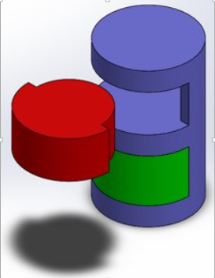
Exit Strategy: Amazon Alexa Rx Investment
Acquisition or merger
First choice: PillPack
Current supplier
Cost savings
Figure #: Rough CAD model of Amazon Alexa Rx
Notes:
Let’s look at what this team did with their Exit Strategy slide.
Note that the title is clear and specific.
The team used minimal text on the slide to describe the options and instead relied on the Notes section to capture the specifics.
In a final draft, the team would re-work the capture for the illustration and make it more informative.

Slide 37
Strategic Issues
If you use text, make it readable.
Use an informative title. Ex., “Addressing Strategic Issues” or “Identifying Strategic Issues”
Insert Graphic
Ex., List of issues
Ex., Illustration of issues
Ex., Flowchart of issues
Ex., Timeline of issues
Notes:
Even the best-planned project will experience problems. The “Strategic Issues” slide is designed to show your investors that you can (and have) anticipated snafus and that you are resilient enough to handle them.
In past projects, other teams’ strategic issues ranged from amount of investment required to lack of start-up manufacturing experience to expertise needed in building coalitions between industry, government, and universities.
Tip: Tone. Tone is very important here. You cannot be dismissive or cocky about future problems. Instead, respect the fact that you’ll be handling the future problems using the investors’ money.
A sample Strategic Issues slide follows.
Transition: Now move to the sum-up or Summary of the presentation. Add a bridge that moves the audience from consideration of your ability to anticipate and handle problems to your product and your plans for its successful launch.

Slide 38
Anatomy of a Strategic Issues Slide
Notes:
This team ran into a last-minute challenge about price. According to their Notes, their customer discovery revealed that customers would be willing to pay the prices indicated above for pillboxes and their home delivery.
However, when challenged, the team was willing to work to shave costs from their manufacturing process (pillbox) and delivery service (medications). These are the strategic issues they identified for their investors.
Tip: Reality Check. Admitting that there are issues to be worked may feel counterintuitive when asking for money. However, funding requests come at the beginning of projects, when the pieces are still moving around. Your job is to be as thorough and confident as possible – based on your planning efforts and the evidence – and show the funders that your team is capable of managing in bad times as well as good.

Slide 39
Summary / Recap of “the Ask”
If you use text, make it readable.
Use an informative title to engage the audience. Ex., “Why Xxxx Will Succeed” or “Your ROI in Xxxx”
Insert Graphic
Ex., Illustration of your product
Ex., Graph showing market growth
Ex., Photo of customers using the product
Notes:
The Summary moves the audience to consider “the big picture” – the problem, how the start-up’s product addresses the gap in the market, all the plans in place for making the product launch a success…
Remember your Purposeful Thesis Statement. This is a good source to help you focus on the 2-3 key take-always for the audience.
The next slide shows a sample Summary slide.
Transition: At the end of this slide, thank the audience for their attention. Say that a list of References follows and that you are now open to questions.

Slide 40
Anatomy of a Summary Slide
Notes:
This slide is partially successful. It leaves the audience with a clear sense of the growth in the online drug market and the attributes of the team.
But, critically, it doesn’t mention the product or the gap that it fills. A better title could help here.
You can only leave the audience with 2-3 key ideas. One of them has to be your product and what it does. This team is proposing to develop an app that ties into several systems and markets via the Amazon Prime database.
Tip: Say vs. Show. Say the attributes, don’t list them. Instead, use the box on the right to highlight the product and its features/benefits. Also, be realistic. Can you claim “youthful exuberance” and then “technical and leadership experience?”
Tip: Repetition. The team should repeat a key idea: the “ask” or the amount of the funding request.

Slide 41
References
Adams, Z. (2014). Bending of an Infinite Beam on an Elastic Substrate. ASME J Appl. Mech., 3,
pp. 221-228. doi: xxxx. Article in a scholarly journal.
Bureau of Labor Statistics, U.S. Department of Labor. (2018, Jan. 30). Occupational Outlook
Handbook, Pharmacists. Retrieved from https://www.bls.gov/ooh/healthcare/pharmacists.htm Statistics via a government website.
Celestina, J.; Mall, C.; Manuszak, P.; Walters, E. (2018). Customer Discovery Survey:
Amazon Pharmaceuticals App Preferences. Detroit, MI: University of DetroitMercy-ENGR 1080. Original research.
Centers for Disease Control and Prevention. (2017, Nov. 18). Heart Disease Facts.
Retrieved from: https://www.cdc.gov/heartdisease/facts.htm Fact sheet from a government website.
Hashish, M. (2000). 600 MPa Waterjet Technology Development. High Pressure
Technology, PVP-406, pp. 135-140. Article in a print journal.
Jones, J. (2000). Contact Mechanics. Cambridge University Press, UK, Chap. 6. Book in print
format.
Juniper Research. (2017, Oct. 17). Smart Store Technologies to Generate over $78 Billion in
Annual Transaction Revenue by 2022. Retrieved from https://www.businesswire.com/news/home/20171010005945/en/Juniper-Research-Smart-Store-Technologies-Generate-78 Article via a business website.
Say, M. (2017, January 20). Amazon Go Is About Payments, Not Grocery. Retrieved
from https://www.forbes.com/sites/groupthink/2017/01/20/amazon-go-is-about-payments-not-grocery/#4950fbec67e4 Article via a magazine website.
Statistica.com, (n.d.). Worldwide mobile app revenues in 2015, 2016 and 2020 (in billion
U.S. dollars). Retrieved from https://www.statista.com/statistics/269025/worldwide-mobile-app-revenue-forecast/ Information via a business website.
Notes:
List your References in APA (American Psychological Association) style unless your instructor indicates otherwise.
Some students offer two lists: One of References and the other of Graphics.
These lists – unlike all your other slides – don’t need to be readable. They are there to show that you have done your homework and that you know how to observe the conventions of professional documents (you cite your sources). So, you can use 10-12 pt. font for References and more than one slide if needed.
Tip: Timing. Scroll past all the References slides – text and graphics – and have the Q and A slide up behind you during discussion.

Slide 42
Q and A
Image from Science News.
Notes:
It is best to have a neutral slide up behind you during Q and A so the audience isn’t distracted. In this case, the team is showing the Agri-Dronz technology again, a subtle reminder of the power of the tiny pollinator they developed.
Tip: Formality. When designing your Q and A slide, remember to maintain the level of formality. You are asking for millions of dollars. Don’t use cartoon-ish graphics to end your request.
Final Thoughts
Creating a presentation is a process, just as written documents are a process. They are constructed in steps so they are manageable.
Credibility is key when making a funding request: Your, your product idea, and your funding pitch (the .ppt) must all be credible.
To help build credibility, proofread, edit, and keep revising based on
Your growing knowledge of your product and your project
Instructor feedback
What you observe other teams doing
BlackBoard resources
Your own research
Good luck. Remember, you have many resources to help you complete this project. So ask! Or call, email, text…you know the drill. ☺

